Slide 1
Comparative Study about intelligent agents on RDF's graphs
Bachelor Project in Semantic Web using random, bee and ant agent

Slide 2
Introduction
The semantic web
Agents details & behaviour
Web UI
Difference between the agents
Main issues
Conclusion

Slide 3
The semantic web
RDF (Resource Description Framework)
Triples
Stores
Entailments

Slide 4
Agents details & behaviour
Random agent
Navigation
Act
Communicate
Evaluate
Applications :
Page-rank like graph
Easy to implement

Slide 5
Agents details & behaviour
Bees
Navigation
Act
Communicate
Evaluate
Applications :
Search

Slide 6
Agents details & behaviour
Ants
Navigation
Act
Communicate
Evaluate
Applications
Shortest path

Slide 7
Web UI
List of agents
Crawled graph
http://localhost:3040

Slide 8
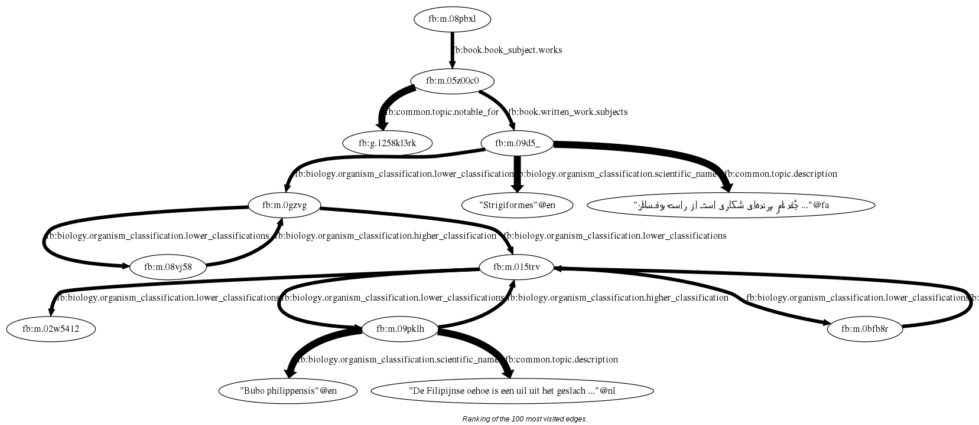
Web UI

Slide 9
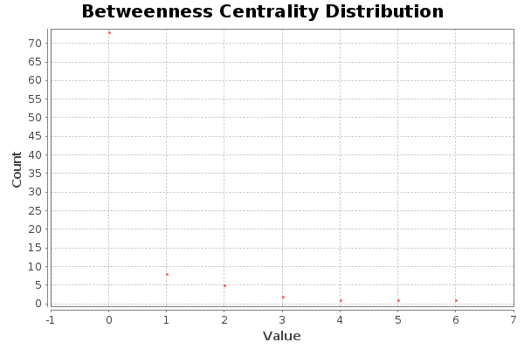
Difference between the agents
Random :
Clustering coefficient : 0

Slide 10
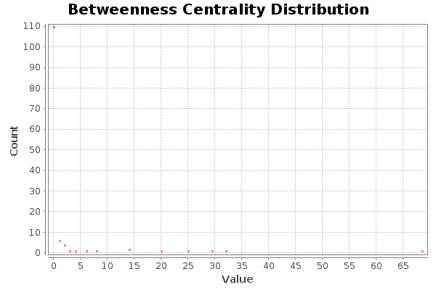
Difference between the agents
Bees :
Clustering coefficient : 0.026

Slide 11
Main issues
Dead end path
Denied access
Difficult tests
Lot of death
Too diverse data
Keep as minimum the communication between threads

Slide 12
Conclusion
Results

Slide 13


Thanks for your attention

